Slide 1
Secure two-party computation:
a visual way
by
Paolo D’Arco and Roberto De Prisco

Slide 2
Challenging Research Task
Design of secure protocols which can be used by people
without the aid of a computer
without cryptographic knowledge
… when computers are not available or, for psycological or social reasons, people feel uncomfortable to interact or trust a computer

Slide 3
In this paper…
By merging together in a suitable way
Yao’s garbled circuit construction (‘80)
Naor and Shamir’s visual cryptography (‘90)
we put forward a novel method for performing secure two-party computation through a pure physical process.

Slide 4
Our Main Result
Theorem 1. Every two-party computation representable by means of a boolean function f(·,·) can be performed preserving the privacy of the inputs x and y through a pure physical visual evaluation process.

Slide 5
Yao’s Construction
[Yao, FOCS 1986]

Slide 6
Computation as a circuit
The boolean function f(·,·) is represented through a boolean circuit
C(·,·) for which, for each x,y, it holds that C(x,y) = f(x,y)
And
And
Or

Slide 7
Computation as a circuit
The boolean function f(·,·) is represented through a boolean circuit
C(·,·) for which, for each x,y, it holds that C(x,y) = f(x,y)
0
1
1
1
Given the input values, the output is easily obtained by evaluating the circuit gates, i.e., And, OR and Not bit-by-bit operations.
And
And
Or

Slide 8
Computation as a circuit
The boolean function f(·,·) is represented through a boolean circuit
C(·,·) for which, for each x,y, it holds that C(x,y) = f(x,y)
0
1
1
1
Given the input values, the output is easily obtained by evaluating the circuit gates, i.e., And, OR and Not bit-by-bit operations.
And
And
0
1
Or

Slide 9
Computation as a circuit
The boolean function f(·,·) is represented through a boolean circuit
C(·,·) for which, for each x,y, it holds that C(x,y) = f(x,y)
0
1
1
1
Given the input values, the output is easily obtained by evaluating the circuit gates, i.e., And, OR and Not bit-by-bit operations.
Inputs are in clear.
Computations are in clear.
No Privacy.
And
And
0
1
Or
1

Slide 10
Using random values
Yao’s idea is to use the circuit as a conceptual guide for the computation which, instead of And, Or and Not operations on bits, becomes a sequence of decryptions of ciphertexts
K_{1,0}, K_{1,1}
K_{2,0}, K_{2,1}
To the wires are associated random values (cryptographic keys), which secretly represent the bits 0 and 1
Or
K_{3,0}, K_{3,1}

Slide 11
Gate tables
(Enc(K, •), Dec(K, •)) symmetric encryption algorithm
w₁ | w₂ | bits | OR | w₃
K_{1,0} | K_{2,0} | 0,0 | 0 | K_{3,0}
K_{1,0} | K_{2,1} | 0,1 | 1 | K_{3,1}
K_{1,1} | K_{2,0} | 1,0 | 1 | K_{3,1}
K_{1,1} | K_{2,1} | 1,1 | 1 | K_{3,1}
Gate table
Enc(K_{1,0} ,Enc(K_{2,0}, K_{3,0}) )
Enc(K_{1,0} ,Enc(K_{2,1}, K_{3,1}) )
Enc(K_{1,1} ,Enc(K_{2,0}, K_{3,1}) )
Enc(K_{1,1} ,Enc(K_{2,1}, K_{3,1}) )
The four double encryptions are stored in a random order.
A gate evaluation ends up in a “correct” double decryption.

Slide 12
Garbled Circuit Construction
G₁
Enc(K_{0,0} ,Enc(K_{1,0}, K_{4,0}) )
Enc(K_{0,0} ,Enc(K_{1,1}, K_{4,0}) )
Enc(K_{0,1} ,Enc(K_{1,0}, K_{4,0}) )
Enc(K_{0,1} ,Enc(K_{1,1}, K_{4,1}) )
G₂
Enc(K_{2,0} ,Enc(K_{3,0}, K_{5,0}) )
Enc(K_{2,0} ,Enc(K_{3,1}, K_{5,0}) )
Enc(K_{2,1} ,Enc(K_{3,0}, K_{5,0}) )
Enc(K_{2,1} ,Enc(K_{3,1}, K_{5,1}) )
K_{1,0}, K_{1,1}
K_{2,0}, K_{2,1}
K_{0,0}, K_{0,1}
K_{3,0}, K_{3,1}
G₁
G₂
K_{4,0}, K_{4,1}
K_{5,0}, K_{5,1}
G₃
Enc(K_{4,0} ,Enc(K_{5,0}, K_{6,0}) )
Enc(K_{4,0} ,Enc(K_{5,1}, K_{6,1}) )
Enc(K_{4,1} ,Enc(K_{5,0}, K_{6,1}))
Enc(K_{4,1} ,Enc(K_{5,1}, K_{6,1}) )
G₃
K_{6,0}, K_{6,1}

Slide 13
Circuit evaluation
Alice (0,0)
Bob (0,1)
G₁
Enc(K_{0,0} ,Enc(K_{1,0}, K_{4,0}) )
Enc(K_{0,0} ,Enc(K_{1,1}, K_{4,0}) )
Enc(K_{0,1} ,Enc(K_{1,0}, K_{4,0}) )
Enc(K_{0,1} ,Enc(K_{1,1}, K_{4,1}) )
G₂
Enc(K_{2,0} ,Enc(K_{3,0}, K_{5,0}) )
Enc(K_{2,0} ,Enc(K_{3,1}, K_{5,0}) )
Enc(K_{2,1} ,Enc(K_{3,0}, K_{5,0}) )
Enc(K_{2,1} ,Enc(K_{3,1}, K_{5,1}) )
K_{1,0}
K_{2,0}
K_{0,0}
K_{3,1}
G₁
G₂
G₃
Enc(K_{4,0} ,Enc(K_{5,0}, K_{6,0}) )
Enc(K_{4,0} ,Enc(K_{5,1}, K_{6,1}) )
Enc(K_{4,1} ,Enc(K_{5,0}, K_{6,1}) )
Enc(K_{4,1} ,Enc(K_{5,1}, K_{6,1}) )
G₃

Slide 14
Circuit evaluation
Alice (0,0)
Bob (0,1)
G₁
Enc(K_{0,0} ,Enc(K_{1,0}, K_{4,0}) )
Enc(K_{0,0} ,Enc(K_{1,1}, K_{4,0}) )
Enc(K_{0,1} ,Enc(K_{1,0}, K_{4,0}) )
Enc(K_{0,1} ,Enc(K_{1,1}, K_{4,1}) )
G₂
Enc(K_{2,0} ,Enc(K_{3,0}, K_{5,0}) )
Enc(K_{2,0} ,Enc(K_{3,1}, K_{5,0}) )
Enc(K_{2,1} ,Enc(K_{3,0}, K_{5,0}) )
Enc(K_{2,1} ,Enc(K_{3,1}, K_{5,1}) )
K_{1,0}
K_{2,0}
K_{0,0}
K_{3,1}
G₁
G₂
G₃
Enc(K_{4,0} ,Enc(K_{5,0}, K_{6,0}) )
Enc(K_{4,0} ,Enc(K_{5,1}, K_{6,1}) )
Enc(K_{4,1} ,Enc(K_{5,0}, K_{6,1}) )
Enc(K_{4,1} ,Enc(K_{5,1}, K_{6,1}) )
G₃

Slide 15
Circuit evaluation
Alice (0,0)
Bob (0,1)
G₁
Enc(K_{0,0} ,Enc(K_{1,0}, K_{4,0}) )
Enc(K_{0,0} ,Enc(K_{1,1}, K_{4,0}) )
Enc(K_{0,1} ,Enc(K_{1,0}, K_{4,0}) )
Enc(K_{0,1} ,Enc(K_{1,1}, K_{4,1}) )
G₂
Enc(K_{2,0} ,Enc(K_{3,0}, K_{5,0}) )
Enc(K_{2,0} ,Enc(K_{3,1}, K_{5,0}) )
Enc(K_{2,1} ,Enc(K_{3,0}, K_{5,0}) )
Enc(K_{2,1} ,Enc(K_{3,1}, K_{5,1}) )
K_{1,0}
K_{2,0}
K_{0,0}
K_{3,1}
G₁
G₂
K_{4,0}
K_{5,0}
G₃
Enc(K_{4,0} ,Enc(K_{5,0}, K_{6,0}) )
Enc(K_{4,0} ,Enc(K_{5,1}, K_{6,1}) )
Enc(K_{4,1} ,Enc(K_{5,0}, K_{6,1}) )
Enc(K_{4,1} ,Enc(K_{5,1}, K_{6,1}) )
G₃

Slide 16
Circuit evaluation
Alice (0,0)
Bob (0,1)
G₁
Enc(K_{0,0} ,Enc(K_{1,0}, K_{4,0}) )
Enc(K_{0,0} ,Enc(K_{1,1}, K_{4,0}) )
Enc(K_{0,1} ,Enc(K_{1,0}, K_{4,0}) )
Enc(K_{0,1} ,Enc(K_{1,1}, K_{4,1}) )
G₂
Enc(K_{2,0} ,Enc(K_{3,0}, K_{5,0}) )
Enc(K_{2,0} ,Enc(K_{3,1}, K_{5,0}) )
Enc(K_{2,1} ,Enc(K_{3,0}, K_{5,0}) )
Enc(K_{2,1} ,Enc(K_{3,1}, K_{5,1}) )
K_{1,0}
K_{2,0}
K_{0,0}
K_{3,1}
G₁
G₂
K_{4,0}
K_{5,0}
G₃
Enc(K_{4,0} ,Enc(K_{5,0}, K_{6,0}) )
Enc(K_{4,0} ,Enc(K_{5,1}, K_{6,1}) )
Enc(K_{4,1} ,Enc(K_{5,0}, K_{6,1}) )
Enc(K_{4,1} ,Enc(K_{5,1}, K_{6,1}) )
G₃

Slide 17
Circuit evaluation
G₁
Enc(K_{0,0} ,Enc(K_{1,0}, K_{4,0}) )
Enc(K_{0,0} ,Enc(K_{1,1}, K_{4,0}) )
Enc(K_{0,1} ,Enc(K_{1,0}, K_{4,0}) )
Enc(K_{0,1} ,Enc(K_{1,1}, K_{4,1}) )
G₂
Enc(K_{2,0} ,Enc(K_{3,0}, K_{5,0}) )
Enc(K_{2,0} ,Enc(K_{3,1}, K_{5,0}) )
Enc(K_{2,1} ,Enc(K_{3,0}, K_{5,0}) )
Enc(K_{2,1} ,Enc(K_{3,1}, K_{5,1}) )
K_{1,0}
K_{2,0}
K_{0,0}
K_{3,1}
G₁
G₂
K_{4,0}
K_{5,0}
G₃
Enc(K_{4,0} ,Enc(K_{5,0}, K_{6,0}) )
Enc(K_{4,0} ,Enc(K_{5,1}, K_{6,1}) )
Enc(K_{4,1} ,Enc(K_{5,0}, K_{6,1}) )
Enc(K_{4,1} ,Enc(K_{5,1}, K_{6,1}) )
G₃
K_{6,0}

Slide 18
Circuit evaluation
G₁
Enc(K_{0,0} ,Enc(K_{1,0}, K_{4,0}) )
Enc(K_{0,0} ,Enc(K_{1,1}, K_{4,0}) )
Enc(K_{0,1} ,Enc(K_{1,0}, K_{4,0}) )
Enc(K_{0,1} ,Enc(K_{1,1}, K_{4,1}) )
G₂
Enc(K_{2,0} ,Enc(K_{3,0}, K_{5,0}) )
Enc(K_{2,0} ,Enc(K_{3,1}, K_{5,0}) )
Enc(K_{2,1} ,Enc(K_{3,0}, K_{5,0}) )
Enc(K_{2,1} ,Enc(K_{3,1}, K_{5,1}) )
K_{1,0}
K_{2,0}
K_{0,0}
K_{3,1}
G₁
G₂
K_{4,0}
K_{5,0}
G₃
Enc(K_{4,0} ,Enc(K_{5,0}, K_{6,0}) )
Enc(K_{4,0} ,Enc(K_{5,1}, K_{6,1}) )
Enc(K_{4,1} ,Enc(K_{5,0}, K_{6,1}) )
Enc(K_{4,1} ,Enc(K_{5,1}, K_{6,1}) )
G₃
K_{6,0}
= 0
… the map (circuit-output key, value)
is public …

Slide 19
Circuit evaluation
G₁
Enc(K_{0,0} ,Enc(K_{1,0}, K_{4,0}) )
Enc(K_{0,0} ,Enc(K_{1,1}, K_{4,0}) )
Enc(K_{0,1} ,Enc(K_{1,0}, K_{4,0}) )
Enc(K_{0,1} ,Enc(K_{1,1}, K_{4,1}) )
G₂
Enc(K_{2,0} ,Enc(K_{3,0}, K_{5,0}) )
Enc(K_{2,0} ,Enc(K_{3,1}, K_{5,0}) )
Enc(K_{2,1} ,Enc(K_{3,0}, K_{5,0}) )
Enc(K_{2,1} ,Enc(K_{3,1}, K_{5,1}) )
K_{1,0}
K_{2,0}
K_{0,0}
K_{3,1}
G₁
G₂
K_{4,0}
K_{5,0}
G₃
Enc(K_{4,0} ,Enc(K_{5,0}, K_{6,0}) )
Enc(K_{4,0} ,Enc(K_{5,1}, K_{6,1}) )
Enc(K_{4,1} ,Enc(K_{5,0}, K_{6,1}) )
Enc(K_{4,1} ,Enc(K_{5,1}, K_{6,1}) )
G₃
K_{6,0}
= 0
… the map (circuit-output key, value)
is public …
The evalution does not release any information about the input bits

Slide 20
How to use the garbled circuit?
Idea: Alice constructs the garbled circuit. Bob gets it, Alice’s keys and … performs the computation.
But … what about Bob’s keys?
Bob cannot communicate his input bits … (privacy lost!)
Does Alice send all of them? Too much … Bob can compute C(x,y) for all possible y.

Slide 21
Oblivious Transfer
Bob secretly gets the keys for each of his input bits (and only for those bits)
Alice |  | Bob
INPUT K_{i,0}, K_{i,1} |  | b (bit choice)
OUTPUT nothing |  | K_{i,b}
Bob gets either K_{i,0} or K_{i,1} (according to b) and no information on the other.
Alice does not know which secret Bob has obtained.

Slide 22
Yao’s Protocol
Alice
constructs the garbled circuit
sends to Bob
the garbled circuit (tables)
the keys associated to her input-wire bits
the correspondence between the keys associated to the circuit-output wires and the bits 0 and 1.
run with Bob n instances of the OT protocol to enable Bob to recover the n keys associated to his input-wire bits
Bob evaluates the circuit (and communicates the result to Alice)

Slide 23
Kolesnikov’s approach: secret sharing
[Asiacrypt 2005] extending the ideas of Ishai&Kushilevitz [ICALP2002]
Instead of using a table with four double encryptions,
use secret sharing
lsh₀
rsh₀
lsh₁
rsh₁
And
Each combination of the shares gives s₀ or s₁
s₀
s₁

Slide 24
Gate Equivalent Secret Sharing
if b=0
if b=1
bR₀
s₀R₀ |s₀R₁
s₀R₁ |s₀R₀
bR₁
s₀R₀ |s₁R₁
s₁R₁ |s₀R₀
And
denotes xor bitwise
s₀,s₁, R₀, R₁ are bitstrings
b is a single bit
s₀
s₁

Slide 25
Gate Equivalent Secret Sharing
0R₀
s₀R₀ |s₀R₁
1R₁
s₀R₀ |s₁R₁
And
denotes xor bitwise
s₀,s₁, R₀, R₁ are bitstrings
b is a single bit
s₀
s₁

Slide 26
Full Protocol: Recursive sharing
1V₀
(s₀R₀ |s₀R₁)V₁|(s₀R₀ |s₀R₁)V₀
0T₀
0R₀T₀ |0R₀T₁
0V₁
(s₀R₀ |s₁R₁)V₁|(s₀R₀ |s₀R₁)V₀
1T₁
0R₀T₀ |1R₁T₁
And
And
0R₀
s₀R₀ |s₀R₁
1R₁
s₀R₀ |s₁R₁
Or
s₀
s₁

Slide 27
Observations
An explicit representation (garbled circuit) is not needed anymore, the circuit is implicitly presents in the input shares
0T₀
0R₀T₀ |0R₀T₁
1V₀
(s₀R₀ |s₀R₁)V₁|(s₀R₀ |s₀R₁)V₀
1T₁
0R₀T₀ |1R₁T₁
0V₁
(s₀R₀ |s₁R₁)V₁|(s₀R₀ |s₀R₁)V₀
Kolesnikov uses secret sharing for optimization issues

Slide 28
Idea…
… but a secret sharing scheme can be realized also through a physical process which
represents the secret as an image
prints the shares on transparencies and
reconstructs the secret by superposing the transparencies and using the human visual system

Slide 29
Visual Cryptography
[Naor&Shamir 1994, Kafri&Karen 1987]

Slide 30
Visual Cryptography
(2,2)-VCS
share 1
secret image
superposition
share 2

Slide 31
Probabilistic Schemes
choosing at random
error probability
superposition (logical or)
share 1
secret pixel
+
+
share 2
Prob = 1/2
choosing at random
superposition (logical or)
share 1
secret pixel
+
+
share 2
Prob = 1

Slide 32
Deterministic Schemes
pixel expansion
choosing at random
share 1
superposition
secret pixel
+
+
share 2
choosing at random
share 1
superposition
secret pixel
+
+
share 2

Slide 33
… but visual cryptography does not realize xor!
1R₀
s₀R₁ |s₀R₀
0R₁
s₁R₁ |s₀R₀
… xor!!!
And
denotes xor bitwise
s₀,s₁, R₀, R₁ are bitstrings
b is a single bit
s₀
s₁
… a closer look: all we need is secret reconstructability
… Kolesnikov’s construction is a special case of a general construction…

Slide 34
Multisecret sharing schemes
sh₂
… |s₀R₁
bR₁
… |s₁R₁
sh₁
sh₃
And
R₁ s₀R₁ = s₀
R₁ s₁R₁ = s₁
Rec( sh₁ , sh₂) = s₀
Rec( sh₁ , sh₃) = s₁
s₀
s₁
The construction in general form can be described in terms of two multisecret sharing schemes for a set of three participants and two secrets

Slide 35
Gate Equivalent Visual Secret Sharing
vlsh₀
vrsh₀
Each combination of the visual shares visually reconstructs image I₀ or image I₁ e.g.,
Rec(vlsh₀, vrsh₀)=I₀
. . .
Rec(vlsh₁, vrsh₁)=I₁
vlsh₁
vrsh₁
And
I₀
I₁
We can do it by using two instances of a visual multi-secret sharing scheme
(see the paper for constructions and details …)

Slide 36
An example

Slide 37
An example

Slide 38
An example

Slide 39
Input shares - Circuit representation

Slide 40
Physical Oblivious Transfer
Assumption: Indistinguishable envelopes exist

Slide 41
Physical Oblivious Transfer
Two-round protocol
1
Prepares two
envelopes with the
visual shares
0
1

Slide 42
Physical Oblivious Transfer
Two-round protocol
1
Prepares two
envelopes with the
visual shares
0
hands to Bob
1
2
0
1

Slide 43
Physical Oblivious Transfer
Two-round protocol
1
Prepares two
envelopes with the
visual shares
0
hands to Bob
3
1
2
Turns his shoulders to Alice
Takes the one of interest
Removes the post-it from
the other
0
1
0
gives back
1
keeps

Slide 44
Physical Oblivious Transfer
Two-round protocol
1
Prepares two
envelopes with the
visual shares
0
hands to Bob
3
1
2
Turns his sholders to Alice
Takes the one of interest
Removes the post-it from
the other
0
1
0
gives back
hands to Alice
1
keeps
4

Slide 45
Physical Oblivious Transfer
Two-round protocol
1
Prepares two
envelopes with the
visual shares
0
hands to Bob
3
1
2
Turns his sholders to Alice
Takes the one of interest
Removes the post-it from
the other
0
1
0
Destroys it under Bob’s
surveillance
gives back
hands to Alice
1
keeps
4
5

Slide 46
VTPC Protocol
Alice constructs the visual shares associated to the input wires
Sends to Bob the shares associated to her input bits
Run with Bob n instances of the physical OT protocol to enable Bob to recover the n visual shares associated to his input bits
Bob visually evaluates the circuit (and communicates the result to Alice)

Slide 47
Visual Evaluation
An example

Slide 48
x₂
y₂
x₃
y₃
G₆
G₇
x₁
y₁
f(x,y)=(x₁+y₁)•[(x₂•y₂)•(x₃+y₃)]
G₂
G₃
Boolean function
Chosen images for bit representation
G₁
0
1

Slide 49
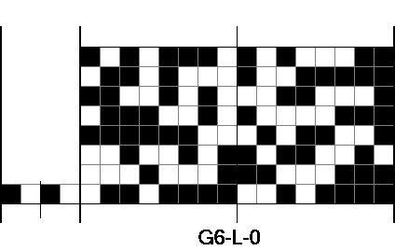
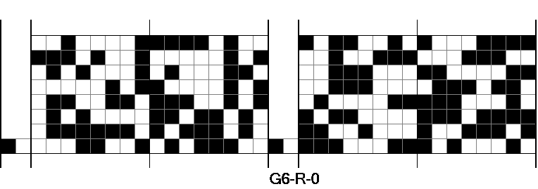
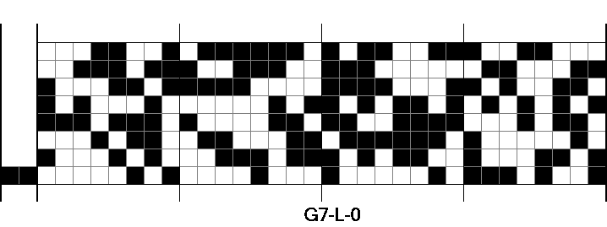
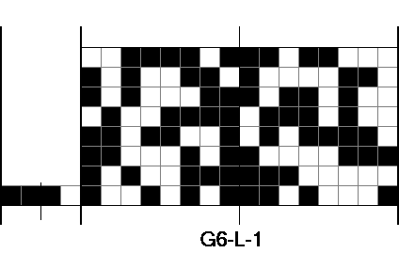
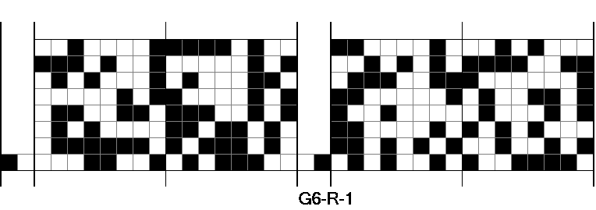
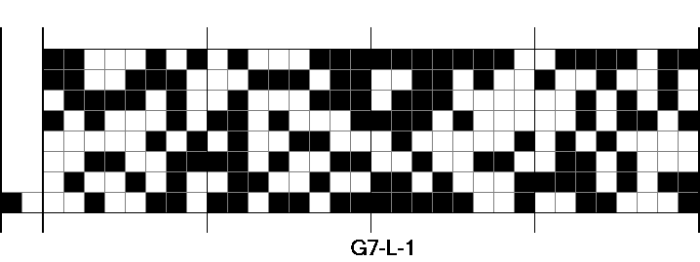
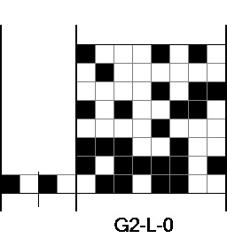
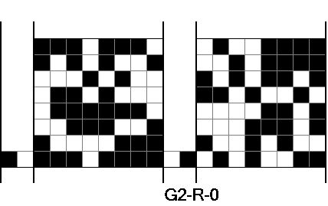
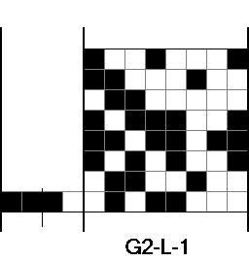
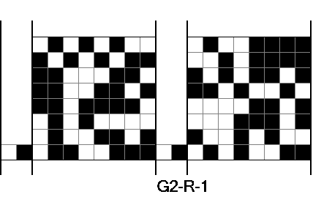
x₂
y₂
x₃
y₃
G₆
G₇
x₁
y₁
G₂
G₃
Input shares constructed by Alice
through the VTPC protocol
G₁

Slide 50
x₂
y₂
x₃
y₃
G₆
G₇
x₁
y₁
G₂
G₃
Shares held by Bob after the OT
protocols, assuming x=011 and y=110
G₁

Slide 51
x₂
y₂
x₃
y₃
G₆
G₇
x₁
y₁
G₂
G₃
Function evaluation
performed by Bob.
G₁

Slide 52
G₆
G₇
G₂
G₃
Function evaluation
performed by Bob.
G₁

Slide 53
G₆
G₇
G₂
G₃
Function evaluation
performed by Bob.
G₁

Slide 54
Conclusions
A novel method for privately evaluating any two party boolean function
The method is unconditionally secure
Visual Cryptography can be also seen as a “computing tool”

Slide 55
Open Problems
Applications
Two party case: malicious adversary
Multi-party case: semi-honest, malicious adversaries
Optimizations: tradeoff security vs efficiency
Use of other visual cryptography schemes
VCS as a tool for crypto-computing in special settings

Slide 56
Thanks!

